Slide 1
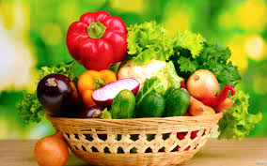
Vegetables
Yummy Yummy(:

Slide 2
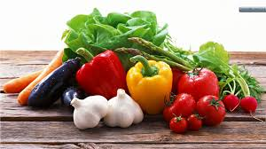
Grouping Vegetables Part of the Plant:
Seeds- Corn, peas, beans
Leaves- Spinach, cabbage, lettuce, bean sprouts
Stem- Celery, Mushrooms, Asparagus
Fruit- Eggplant, Squash, Avocados, Cucumbers
Flower- Cauliflower, Broccoli
Roots- Carrot, Radish
Tubers- Potatoes
Bulbs- Garlic, Fennel

Slide 3
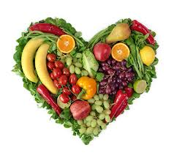
Flavor- Varies
Mild- Beans and Corn
Strong- Turnips, Cauliflower, Onions, Garlic

Slide 4
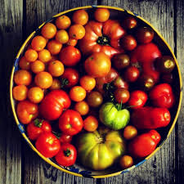
Nutrient Value- Influenced by part of the plant it comes from.
Top part- (fruit, flower, leaves, upper stem) are usually HIGH in water content
Lower part- (root, seed, lower stem) are usually HIGH in starch or CHO
Color- Shows the nutritive value of that part
Deep green and yellow- High in Vitamin A
Leafy green- Good source of Vitamin C, Calcium, Iron

Slide 5
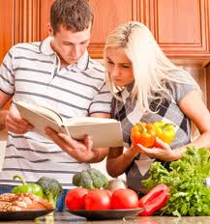
Preparing Vegetables
Broiled- Tomatoes and Squash
Boiled- Potatoes, Corn-on-cob
Baked- Potatoes, Squash, Zucchini
Braised- Mushrooms, Carrots
Fried- Hash browns, Onions
Steamed- Broccoli, Spinach
Pressure cooked

Slide 6
A Few Hints to Remember…
Cook vegetable only until tender in order to retain their flavor, texture, color, appearance, and nutritional value
Vegetables retain most nutritional value if cooked with the skin on
Shorten cooking time if veggies are cut, sliced, diced, or shredded
Start veggies in boiling water, using the smallest amount of water possible, with the lid on
Retain water from cooking veggies to use in soups or sauces (nutrients and flavor are left in the water)

Slide 7
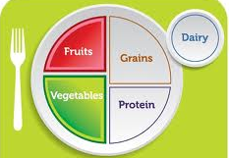
Recommended Servings Per Day
Veggies are incomplete proteins, because they are not from an animal source - need to be paired with another incomplete (like nuts, or legumes) to make a complete protein
Cholesterol is an animal based compound- it is essential for our daily functions, but too much or too little causes problems. Depends upon your heredity, environment, and exercise.

Slide 8
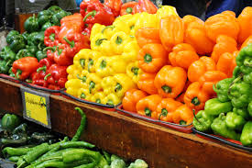
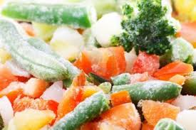
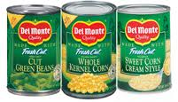
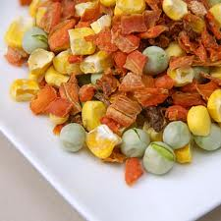
Vegetables can be Purchased:
Fresh
Frozen
Canned
Dried

